Slide 1
Unit 5: Random Processes and Noise
EL-GY 6013: Digital communications
Prof. Sundeep rangan

Slide 2
Learning Objectives
Compute expectations and probabilities for random variables
Compute expectations and probabilities for real and complex random variables
Generate samples of random variables in MATLAB
Continuous and discrete-time
Compute probabilities of Gaussians and linear combinations of Gaussian
Write answers in terms of the Q-function
Compute probabilities of multiple variables with conditional distributions
Use total expectation, total probability, conditioning rule, …
Simulate random systems with multiple random variables
Simulate and describe random processes
Compute auto-correlation and PSD of a random process

Slide 3
This Unit
Channel coding
Symbol mapping
TX filter DAC
Upconversion
Info bits
Coded bits
IQ symbols
Analog baseband
RF
Passband
Channel
Sync
“Noise”
Channel decoding
Symbol demod
Equalization
RX filter and ADC
Down-conversion

Slide 4
Outline
What is noise?
Random variables
Simulating random variables
Gaussian and complex Gaussian random variables
Random vectors
Random processes

Slide 5
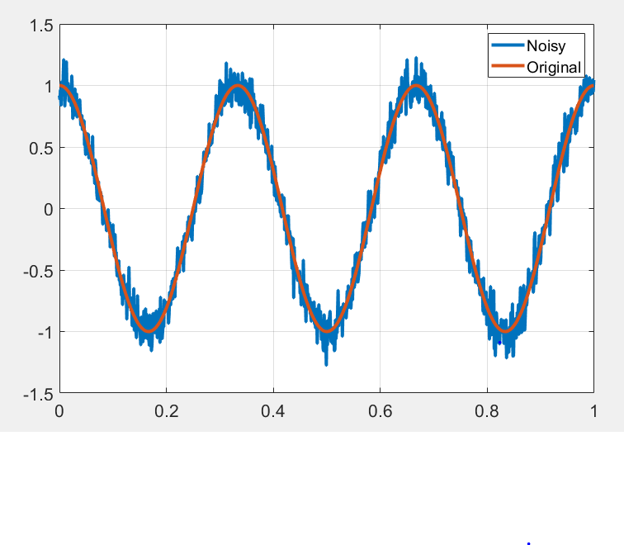
What is Noise?
Noise: Any unwanted component of the signal
Key challenge in communication:
Estimate the transmitted signal in the presence of noise
Two main sources of noise:
Thermal noise: Physical noise in the receiver
Interference: Signals from other sources

Slide 6
Statistical Models for Noise
In communications, we model noise as a random process
Captures “uncertainty” in the value
This lecture:
Review basics of probability and random processes
Describe mathematical model for noise

Slide 7
Outline
What is noise?
Random variables
Simulating random variables
Gaussian and complex Gaussian random variables
Random vectors
Random processes

Slide 8
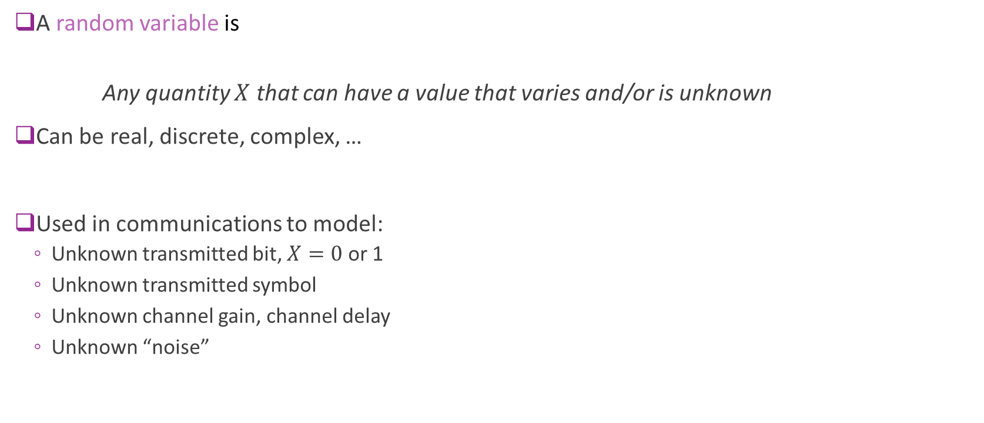
Random Variables: Informal Definition
A random variable is
Any quantity $X$ that can have a value that varies and/or is unknown
Can be real, discrete, complex, …
Used in communications to model:
Unknown transmitted bit, $X=0$ or 1
Unknown transmitted symbol
Unknown channel gain, channel delay
Unknown “noise”

Slide 9
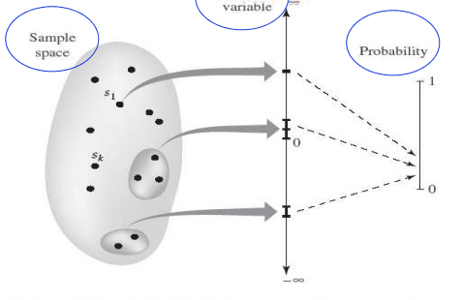
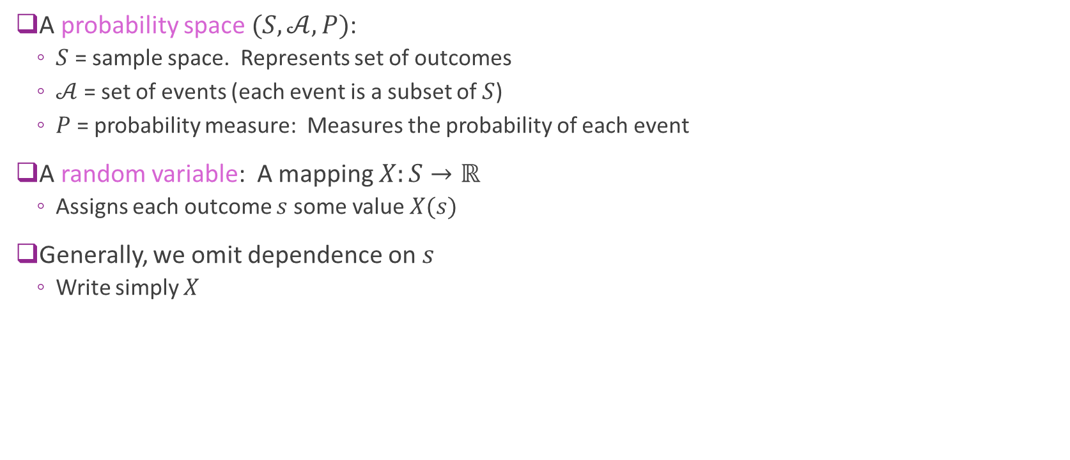


Random Variables: Formal Definition
A probability space $(S,𝒜,P)$:
$S$ = sample space. Represents set of outcomes
$𝒜$ = set of events (each event is a subset of $S$)
$P$ = probability measure: Measures the probability of each event
A random variable: A mapping $X:S→ℝ$
Assigns each outcome $s$ some value $X(s)$
Generally, we omit dependence on $s$
Write simply $X$
Values $X\left(s\right)∈ℝ$
S
Sample space $S$
Probability

Slide 10
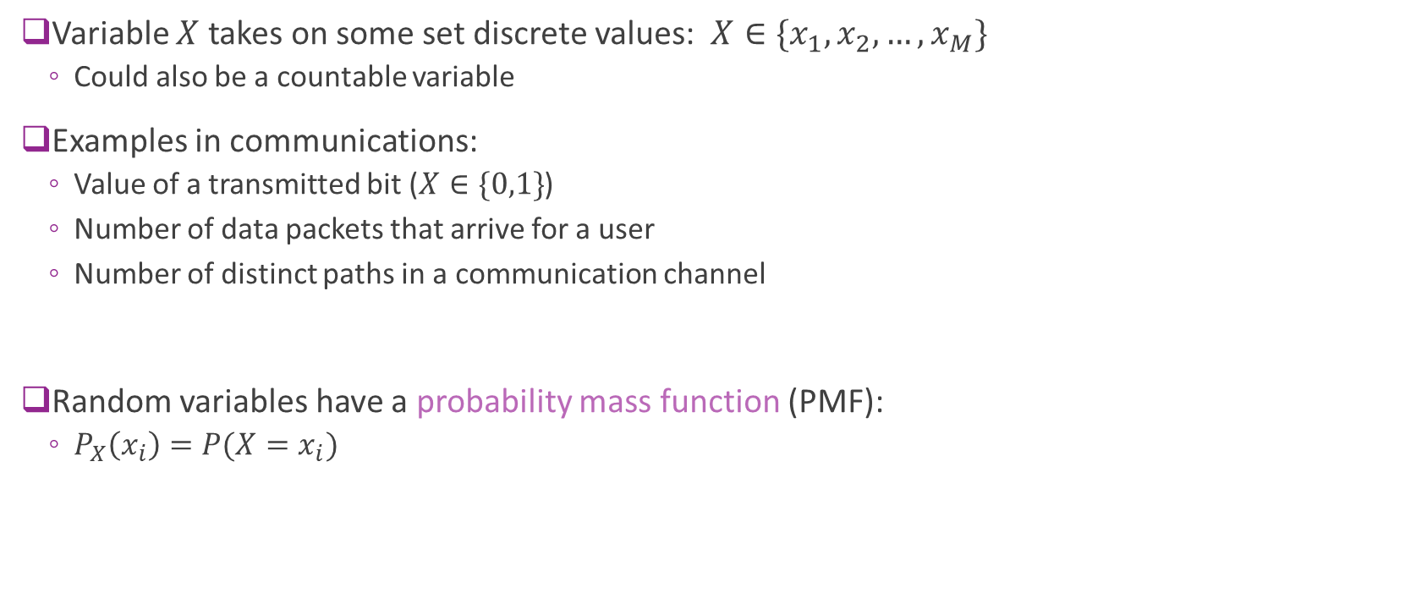
Discrete Random Variables
Variable $X$ takes on some set discrete values: $X∈\{x_{1},x_{2},…,x_{M}\}$
Could also be a countable variable
Examples in communications:
Value of a transmitted bit ($X∈\{0,1\}$)
Number of data packets that arrive for a user
Number of distinct paths in a communication channel
Random variables have a probability mass function (PMF):
$P_{X}\left(x_{i}\right)=P(X=x_{i})$

Slide 11
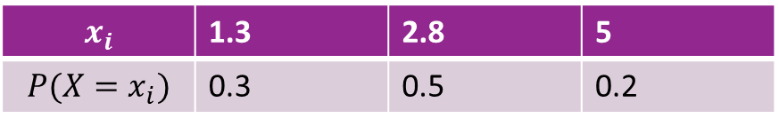
Visualizing the PMF
Represent PMF via a stem plot or table
$$x_{i}$$ | 1.3 | 2.8 | 5
$$P(X=x_{i})$$ | 0.3 | 0.5 | 0.2
0.5
0.3
0.2
1.3
2.8
5

Slide 12
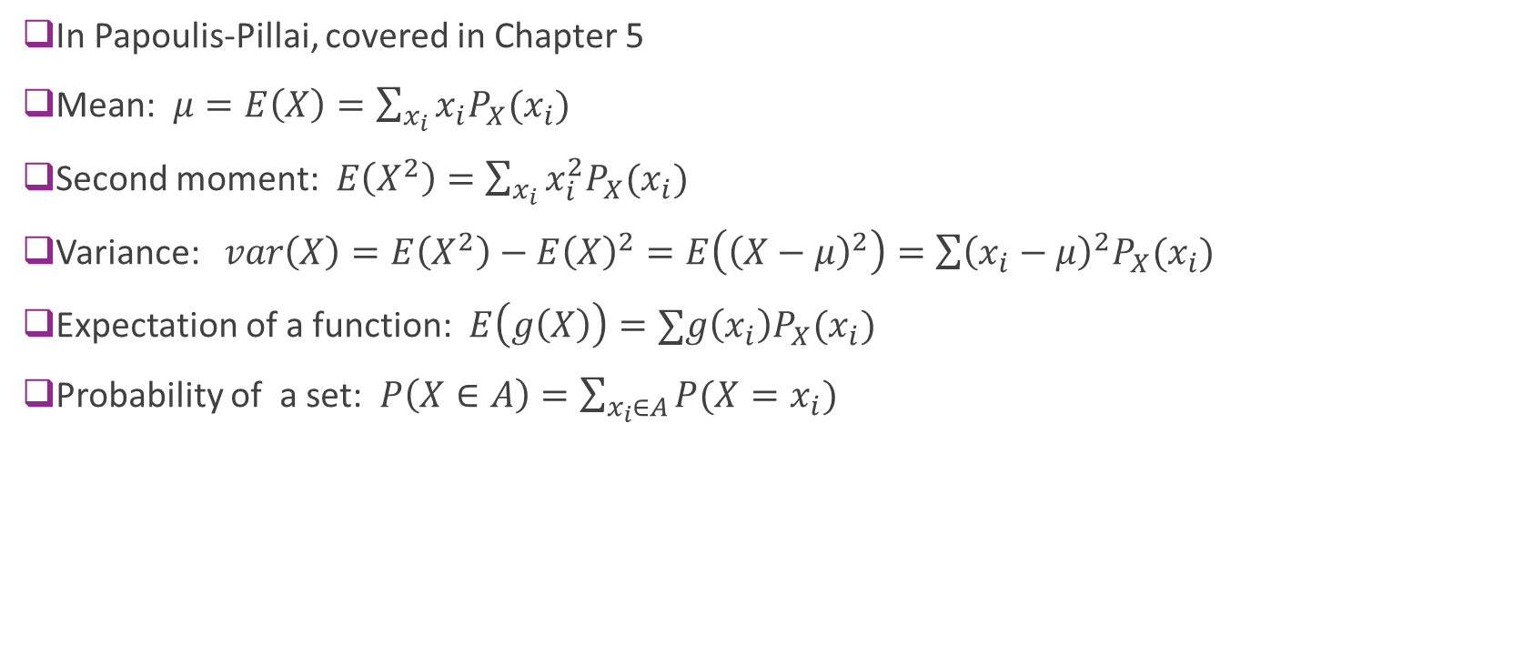
Expectations (Discrete r.v.s)
In Papoulis-Pillai, covered in Chapter 5
Mean: $μ=E\left(X\right)=\sum_{x_{i}}{{x_{i}P}_{X}(x_{i})}$
Second moment: $E\left(X^{2}\right)=\sum_{x_{i}}{x_{i}^{2}P_{X}(x_{i})}$
Variance: $var\left(X\right)=E\left(X^{2}\right)−E{\left(X\right)}^{2}=E\left({\left(X−μ\right)}^{2}\right)=\sum{{\left(x_{i}−μ\right)}^{2}P_{X}(x_{i})}$
Expectation of a function: $E\left(g\left(X\right)\right)=∑g\left(x_{i}\right)P_{X}(x_{i})$
Probability of a set: $P\left(X∈A\right)=\sum_{x_{i}∈A}{P(X=x_{i})}$

Slide 13
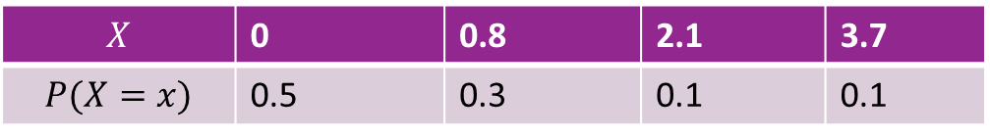
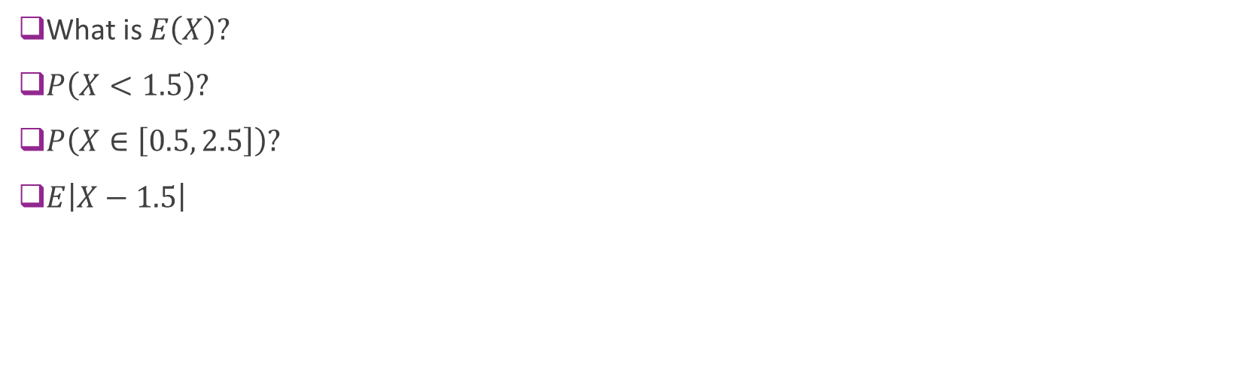
Example Problem
$$X$$ | 0 | 0.8 | 2.1 | 3.7
$$P(X=x)$$ | 0.5 | 0.3 | 0.1 | 0.1
What is $E\left(X\right)?$
$P\left(X<1.5\right)?$
$P\left(X∈\left[0.5, 2.5\right]\right)?$
$E\left|X−1.5\right|$

Slide 14
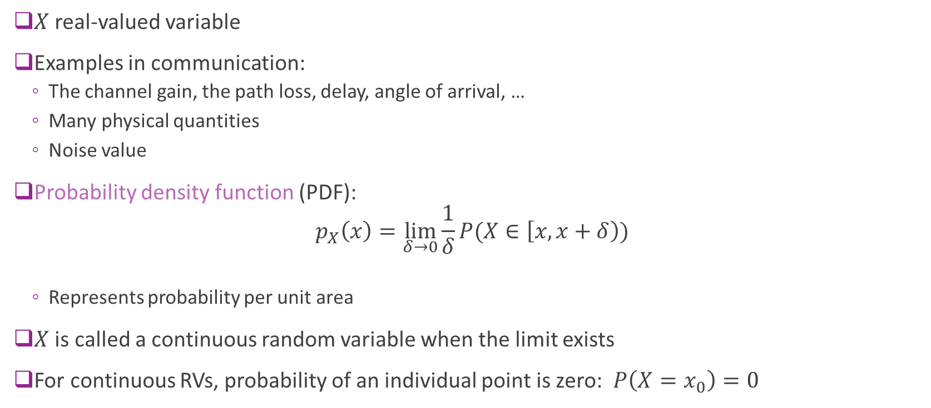
Continuous Random Variables
$X$ real-valued variable
Examples in communication:
The channel gain, the path loss, delay, angle of arrival, …
Many physical quantities
Noise value
Probability density function (PDF): $p_{X}\left(x\right)=\lim_{δ→0}{\frac{1}{δ}P(X∈\left[x,x+δ\right))}$
Represents probability per unit area
$X$ is called a continuous random variable when the limit exists
For continuous RVs, probability of an individual point is zero: $P\left(X=x_{0}\right)=0$

Slide 15
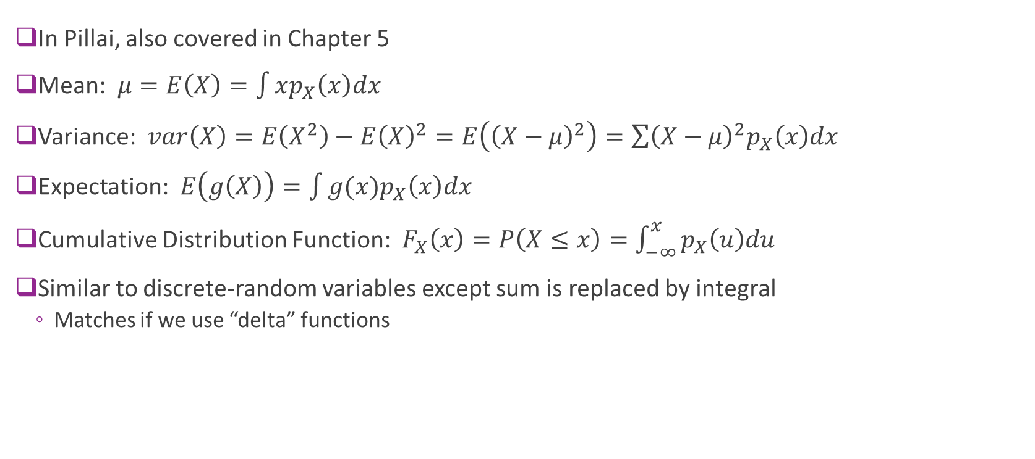
Expectation (Continuous r.v.s)
In Pillai, also covered in Chapter 5
Mean: $μ=E\left(X\right)=\int{xp_{X}\left(x\right)dx}$
Variance: $var\left(X\right)=E\left(X^{2}\right)−E{\left(X\right)}^{2}=E\left({\left(X−μ\right)}^{2}\right)=\sum{{\left(X−μ\right)}^{2}p_{X}\left(x\right)dx}$
Expectation: $E\left(g\left(X\right)\right)=\int{g(x)p_{X}\left(x\right)dx}$
Cumulative Distribution Function: $F_{X}\left(x\right)=P\left(X≤x\right)=\int_{−∞}^{x}{p_{X}\left(u\right)du}$
Similar to discrete-random variables except sum is replaced by integral
Matches if we use “delta” functions

Slide 16
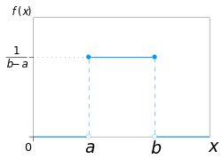
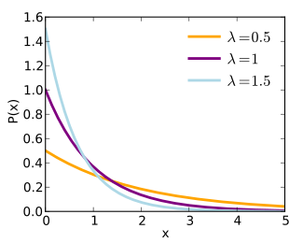
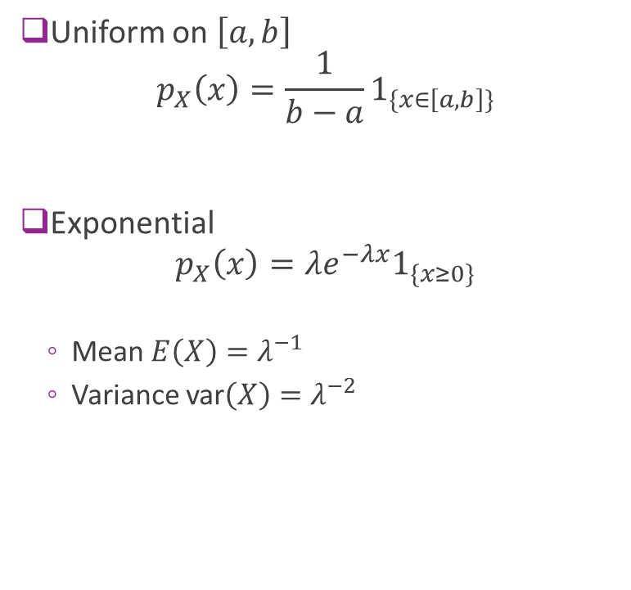
Examples
Uniform on $\left[a,b\right]$ $p_{X}\left(x\right)=\frac{1}{b−a}1_{\{x∈\left[a,b\right]\}}$
Exponential $p_{X}\left(x\right)=λe^{−λx}1_{\{x≥0\}}$
Mean $E\left(X\right)=λ^{−1}$
Variance var$\left(X\right)=λ^{−2}$

Slide 17
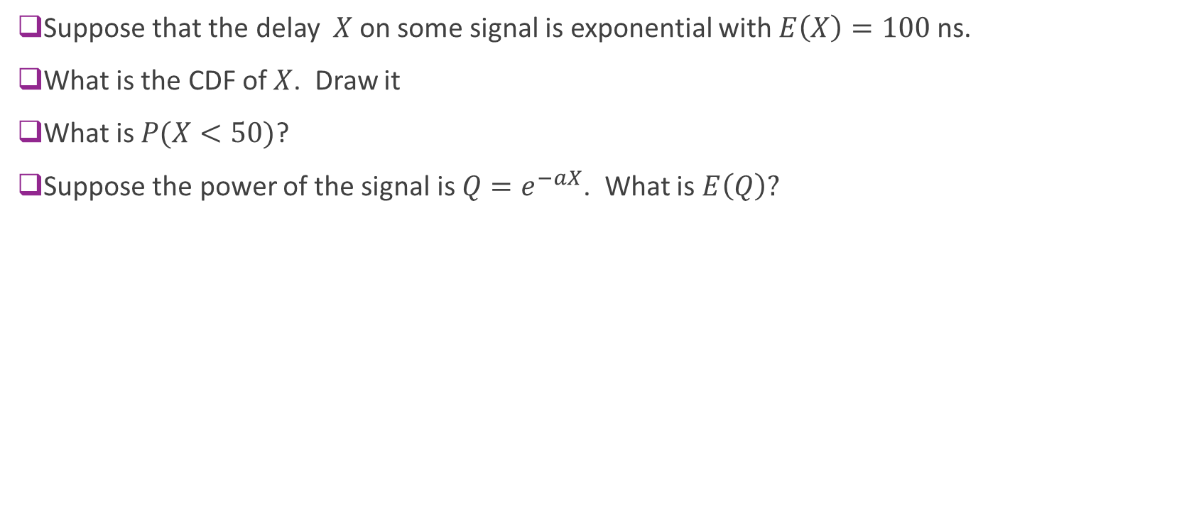
Example Problem
Suppose that the delay $X$on some signal is exponential with $E\left(X\right)=100$ns.
What is the CDF of $X$. Draw it
What is $P(X<50)$?
Suppose the power of the signal is $Q=e^{−aX}$. What is $E\left(Q\right)?$

Slide 18
Outline
What is noise?
Random variables
Simulating random variables
Gaussian and complex Gaussian random variables
Random vectors
Random processes

Slide 19
Sampling Random Variables
Often need to generate independent samples of random variables in MATLAB
Most importantly, to simulate systems with random models
MATLAB has many routines to generate random samples
Discrete random variables
Continuous random variables
Most standard distributions

Slide 20
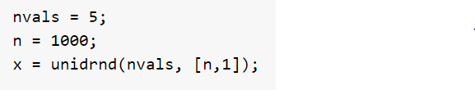
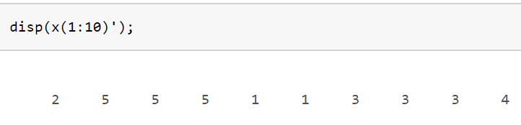
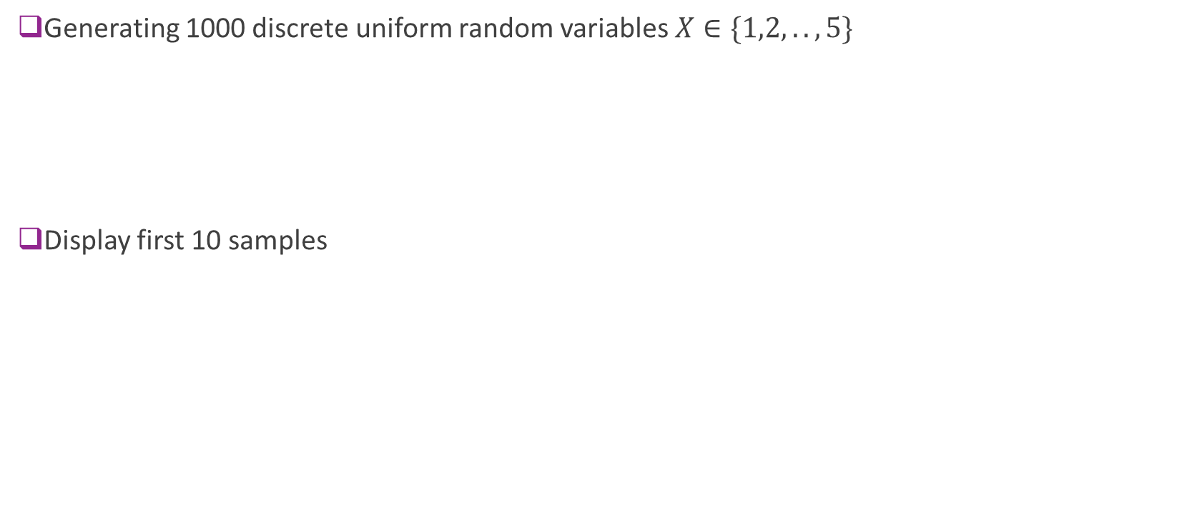
Ex: Discrete Uniform Random Variables
Generating 1000 discrete uniform random variables $X∈\{1,2,..,5\}$
Display first 10 samples

Slide 21
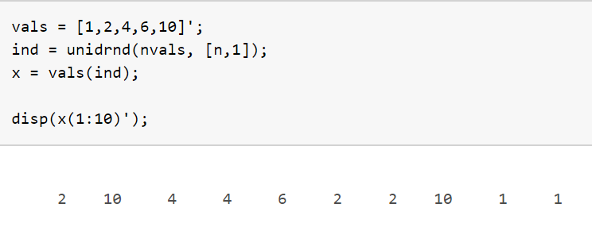
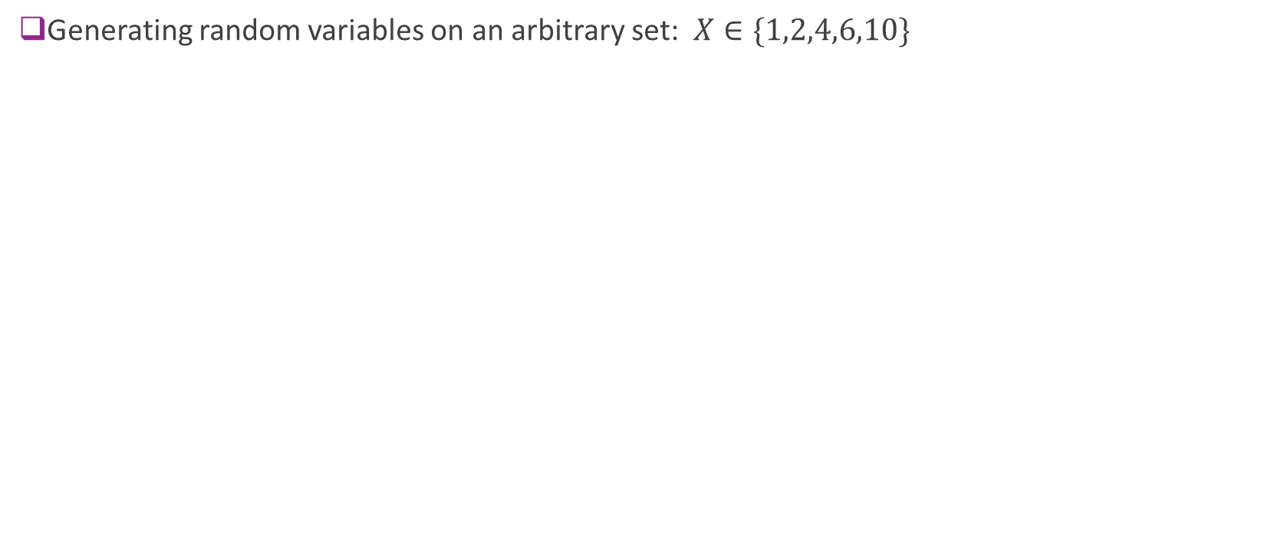
Ex 2. Discrete Uniform on a Set
Generating random variables on an arbitrary set: $X∈\{1,2,4,6,10\}$

Slide 22
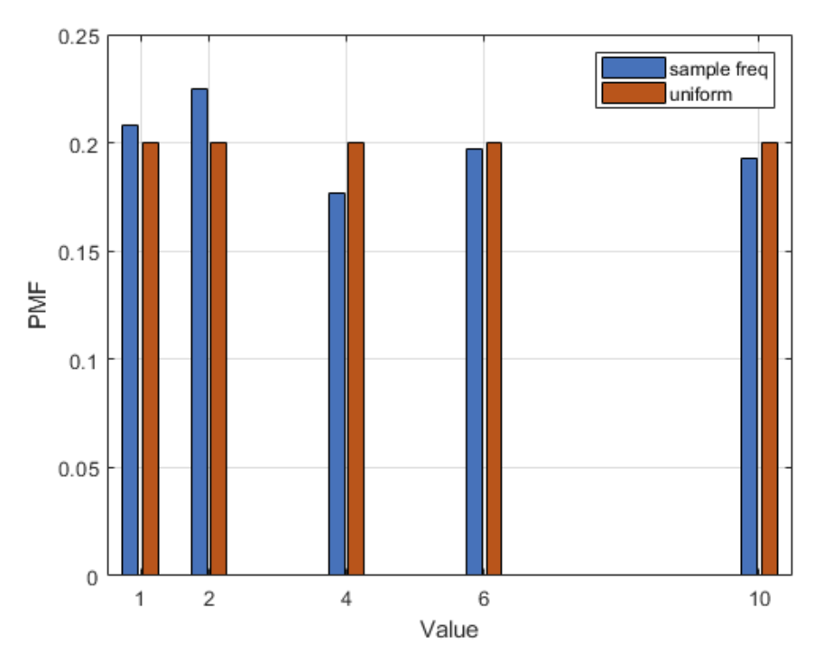
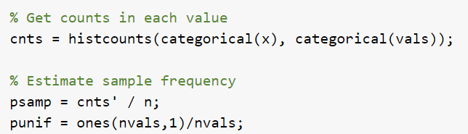
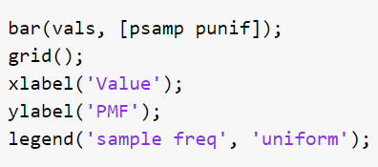
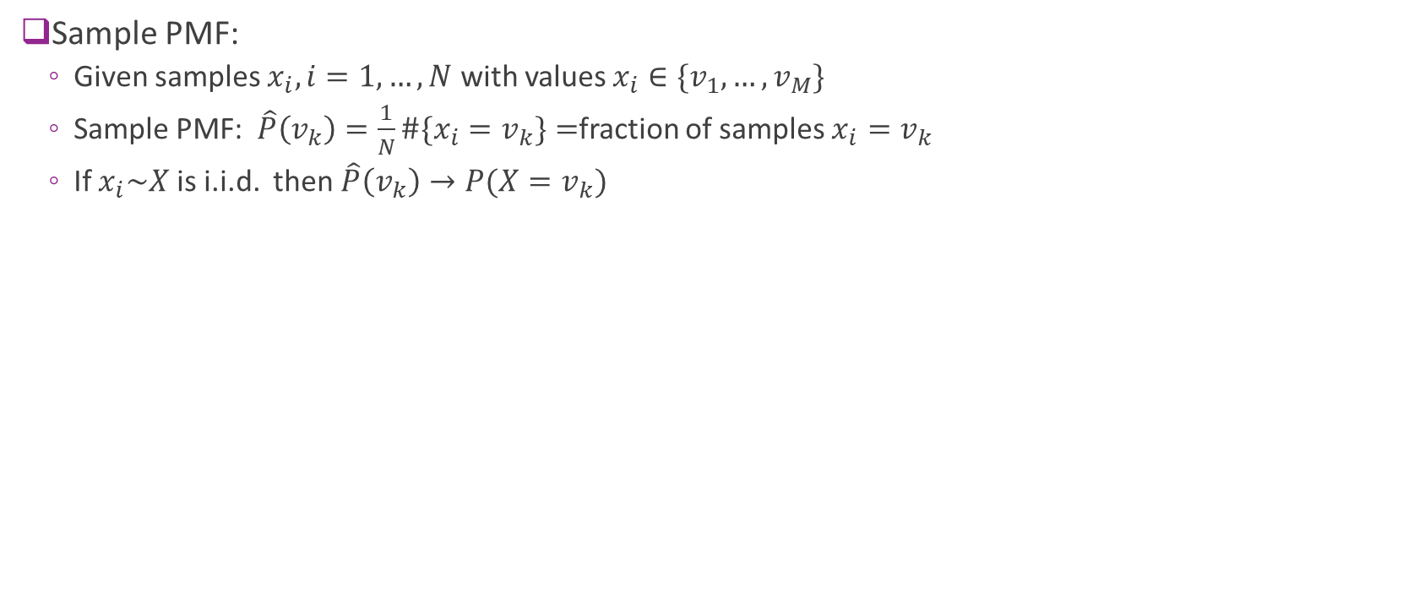
Measuring and Plotting the PMF
Sample PMF:
Given samples $x_{i},i=1,…,N$ with values $x_{i}∈\{v_{1},…,v_{M}\}$
Sample PMF: $\hat{P}\left(v_{k}\right)=\frac{1}{N}\#\{x_{i}=v_{k}\}=$fraction of samples $x_{i}=v_{k}$
If $x_{i}\sim X$ is i.i.d. then $\hat{P}\left(v_{k}\right)→P(X=v_{k})$

Slide 23
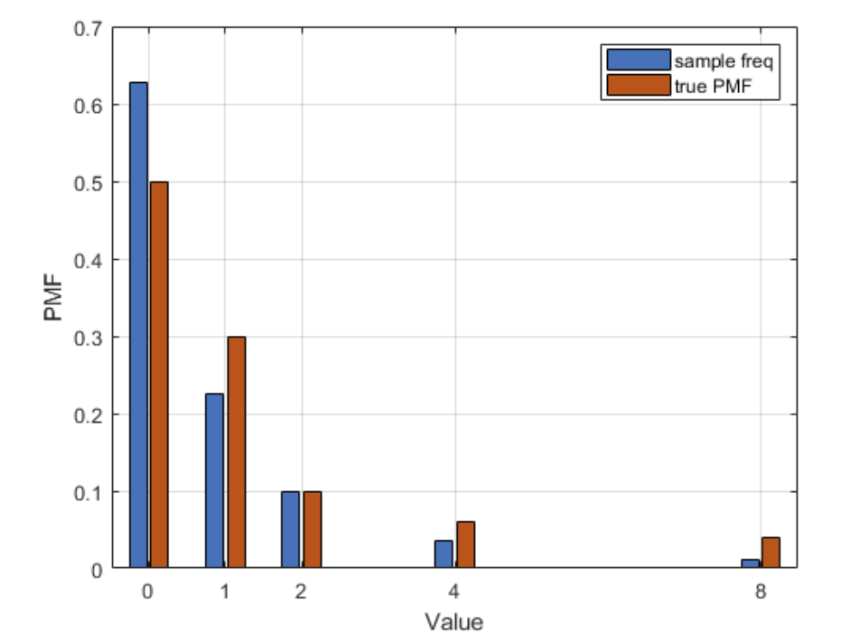
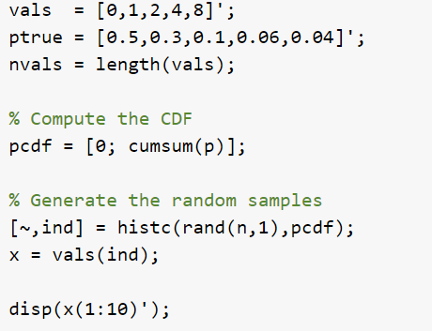
Ex 3: Non-Uniform Discrete RV
Generating a random variable with a given PMF

Slide 24
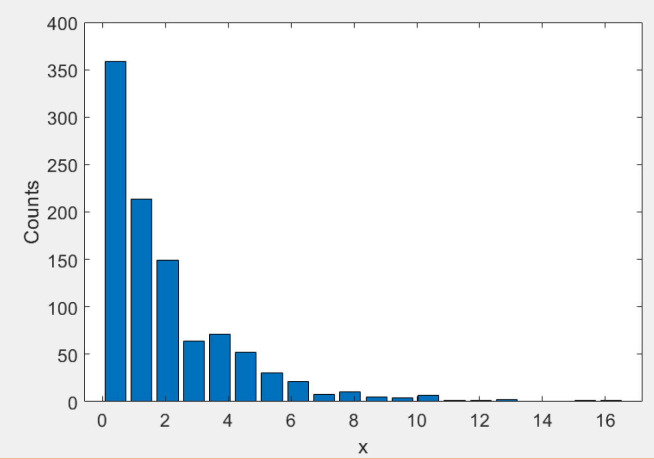
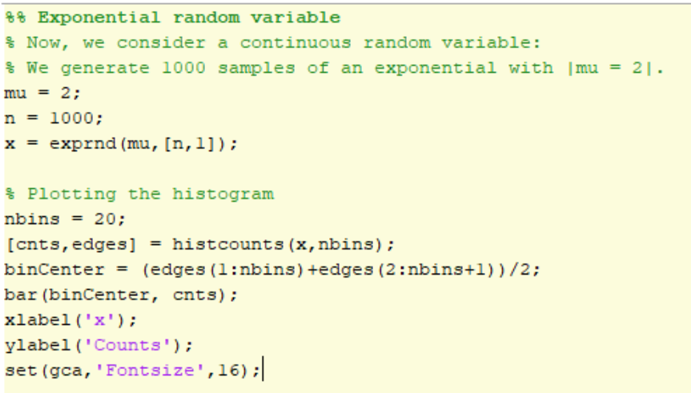
Ex 4. Exponential Random Variable
Can generate many standard random variables

Slide 25
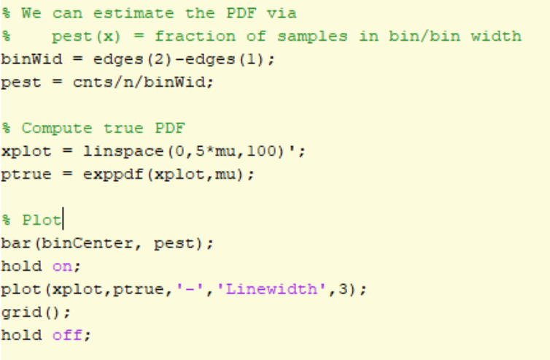
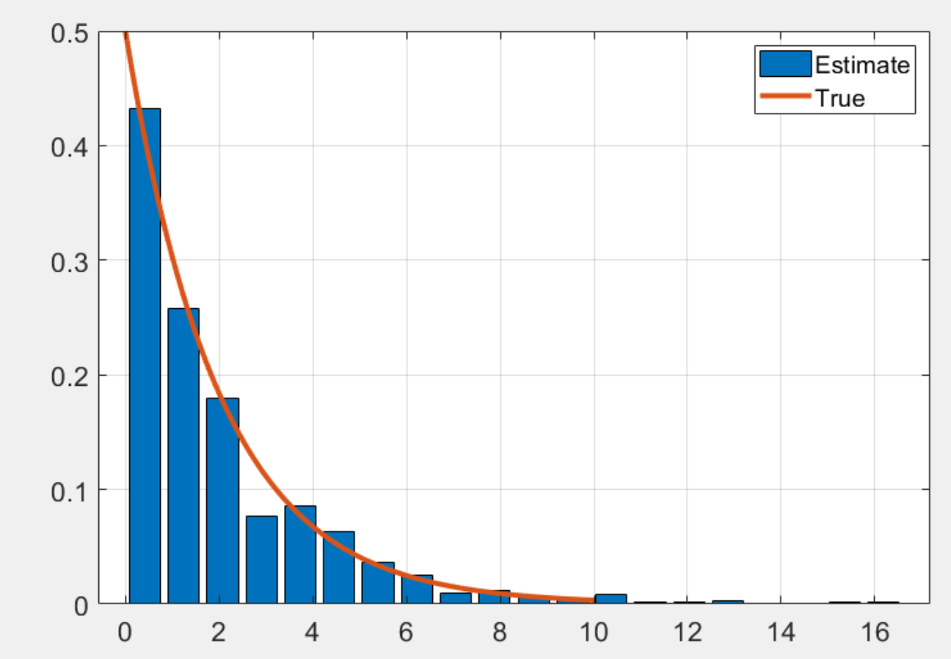
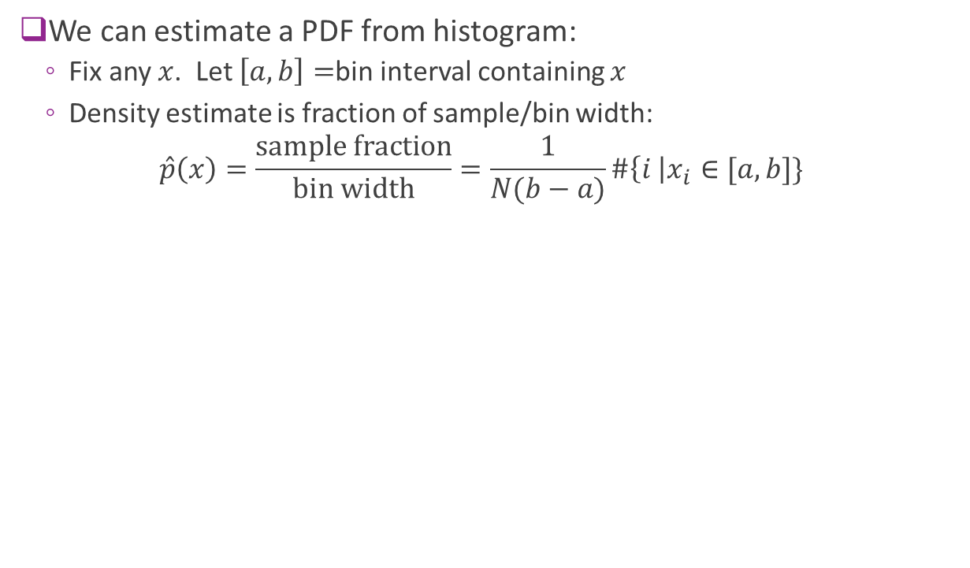
Estimating a PDF
We can estimate a PDF from histogram:
Fix any $x$. Let $\left[a,b\right]=$bin interval containing $x$
Density estimate is fraction of sample/bin width:
$$\hat{p}\left(x\right)=\frac{\text{sample} \text{fraction}}{\text{bin} \text{width}}=\frac{1}{N(b−a)}\#\left\{i \right|x_{i}∈[a,b]\}$$

Slide 26
Outline
What is noise?
Random variables
Simulating random variables
Gaussian and complex Gaussian random variables
Random vectors
Random processes

Slide 27
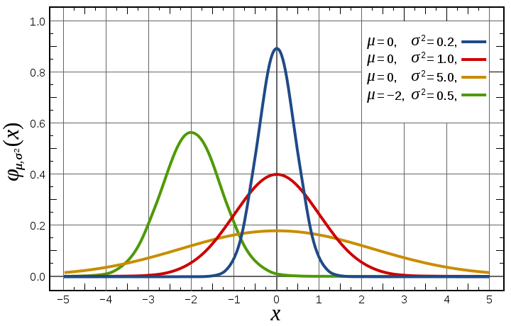
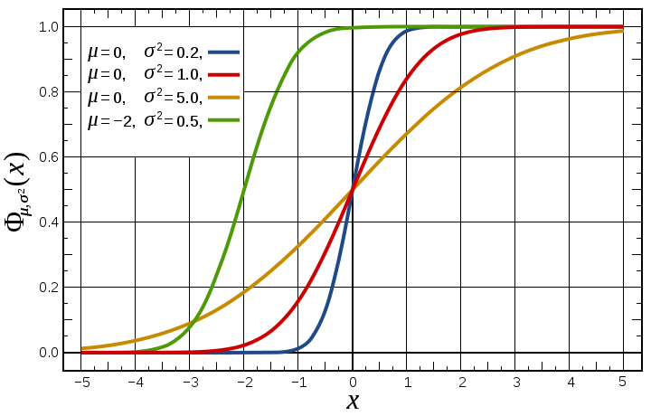
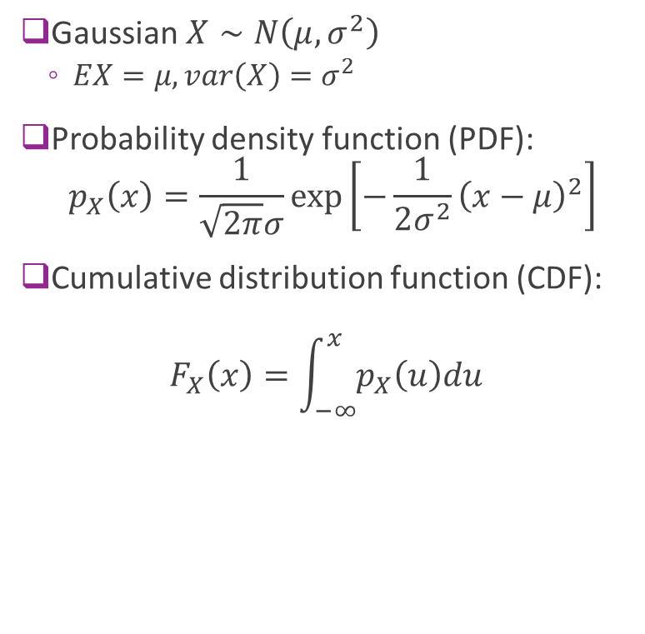
Gaussian Random Variables
Gaussian $X∼N\left(μ, σ^{2}\right)$
$EX=μ, var\left(X\right)=σ^{2}$
Probability density function (PDF): $p_{X}\left(x\right)=\frac{1}{\sqrt{2π}σ}\exp\left[−\frac{1}{2σ^{2}}{\left(x−μ\right)}^{2}\right]$
Cumulative distribution function (CDF): $F_{X}\left(x\right)=\int_{−∞}^{x}{p_{X}\left(u\right)du}$

Slide 28
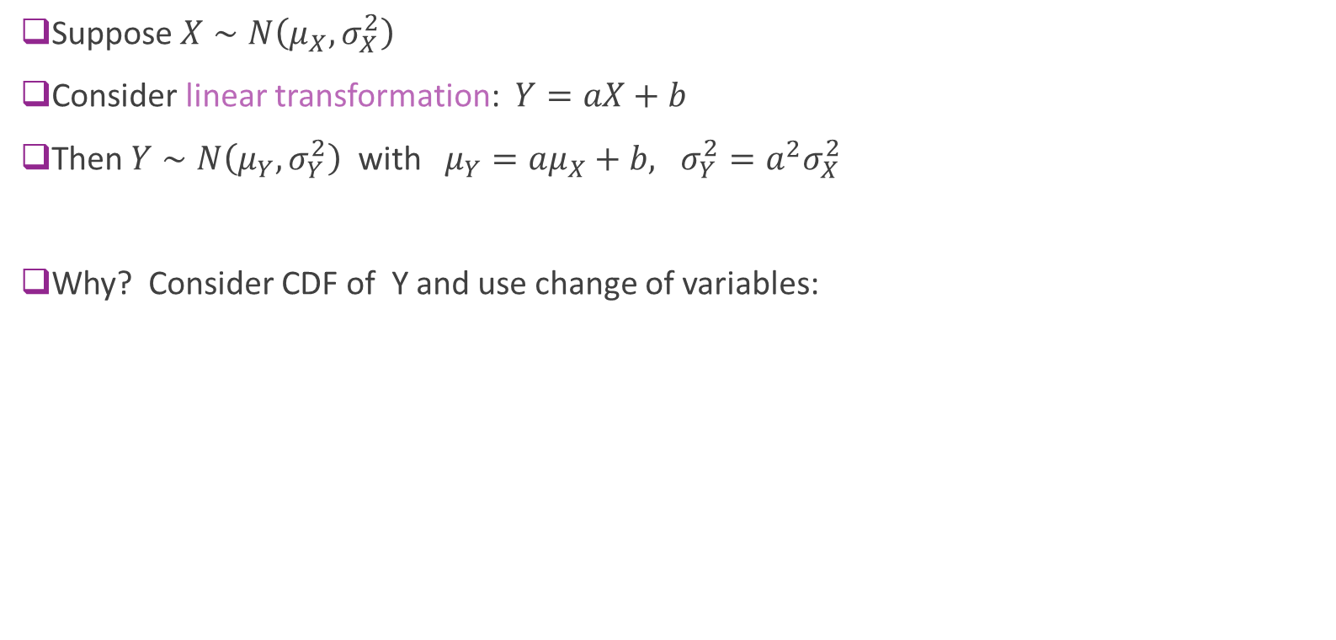
Linear Transformations of Gaussians
Suppose $X∼N\left(μ_{X}, σ_{X}^{2}\right)$
Consider linear transformation: $Y=aX+b$
Then $Y∼N\left(μ_{Y}, σ_{Y}^{2}\right)$ with $μ_{Y}=aμ_{X}+b, σ_{Y}^{2}=a^{2}σ_{X}^{2}$
Why? Consider CDF of Y and use change of variables:

Slide 29
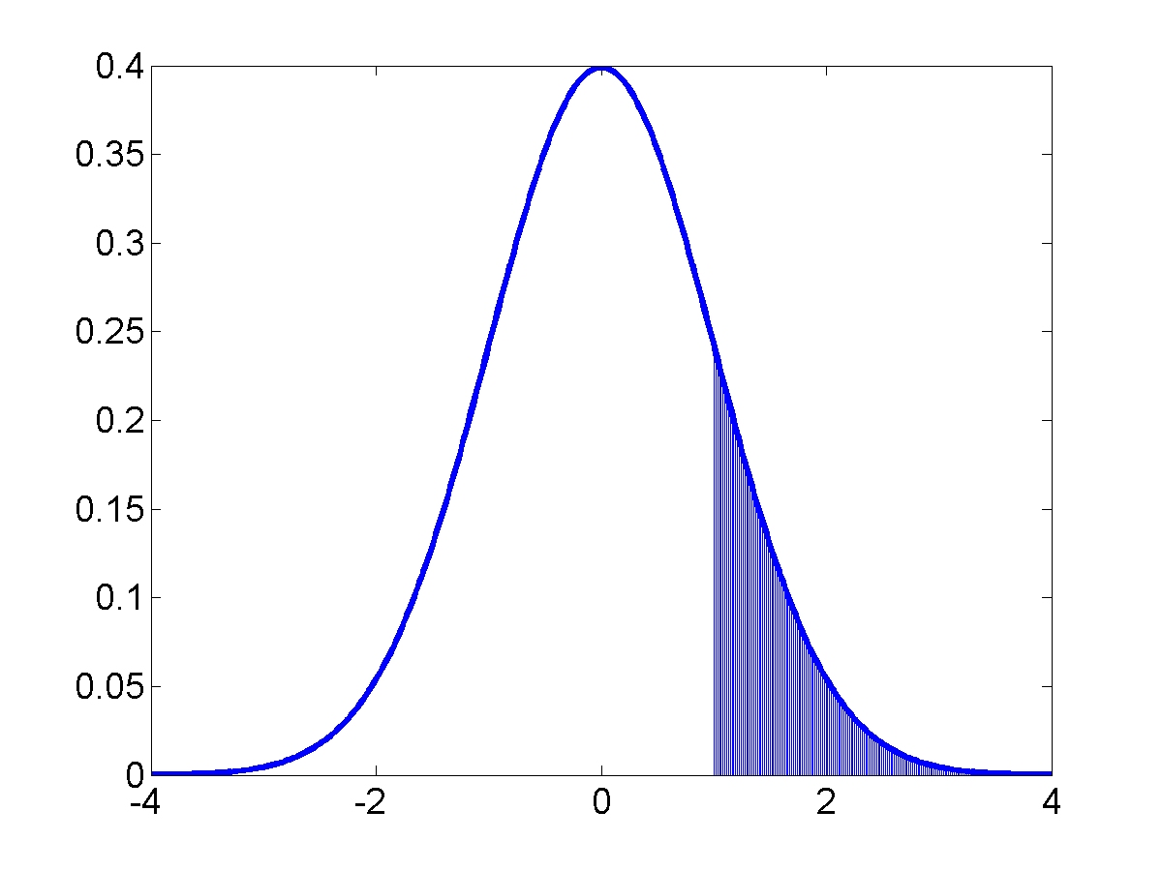
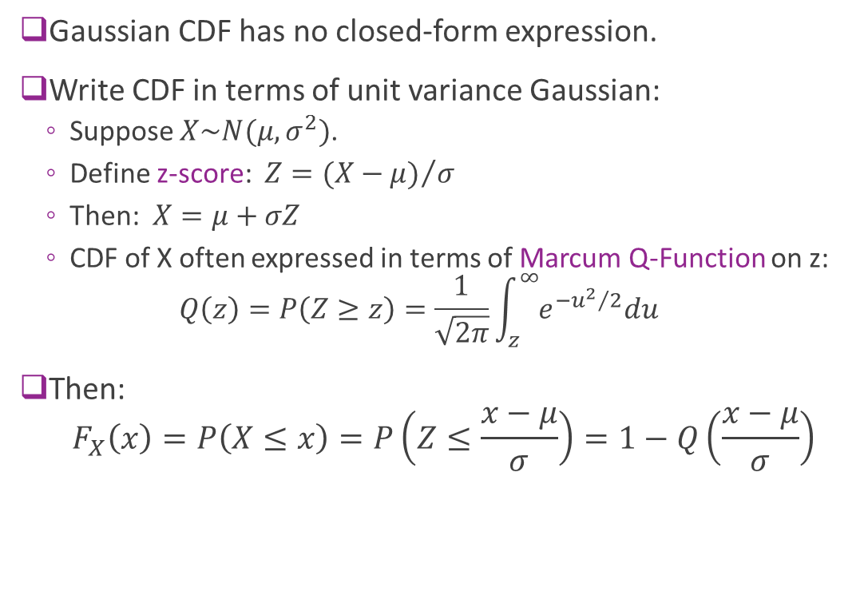
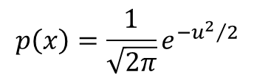
Gaussian CDF and Q Function
Gaussian CDF has no closed-form expression.
Write CDF in terms of unit variance Gaussian:
Suppose $X\sim N(μ,σ^{2})$.
Define z-score: $Z={(X−μ)}/σ$
Then: $X=μ+σZ$
CDF of X often expressed in terms of Marcum Q-Function on z: $Q\left(z\right)=P\left(Z≥z\right)=\frac{1}{\sqrt{2π}}\int_{z}^{∞}{e^{−{u^{2}}/2}du}$
Then: $F_{X}\left(x\right)=P\left(X≤x\right)=P\left(Z≤\frac{x−μ}{σ}\right)=1−Q\left(\frac{x−μ}{σ}\right)$
$$p\left(x\right)=\frac{1}{\sqrt{2π}}e^{−{u^{2}}/2}$$
z
Q(z) = area under curve

Slide 30
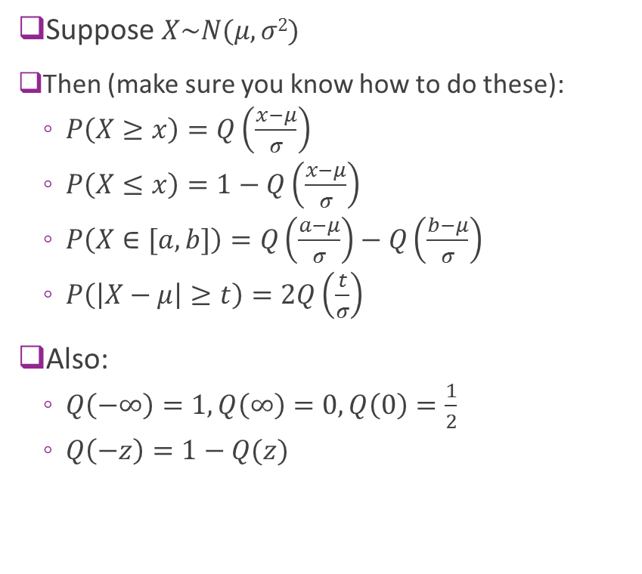
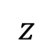
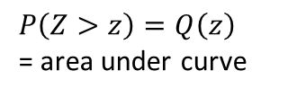
Properties of the Q Function
Suppose $X\sim N(μ,σ2)$
Then (make sure you know how to do these):
$P\left(X≥x\right)=Q\left(\frac{x−μ}{σ}\right)$
$P\left(X≤x\right)=1−Q\left(\frac{x−μ}{σ}\right)$
$P\left(X∈[a,b]\right)=Q\left(\frac{a−μ}{σ}\right)−Q\left(\frac{b−μ}{σ}\right)$
$P\left(\left|X−μ\right|≥t\right)=2Q\left(\frac{t}{σ}\right)$
Also:
$Q\left(−∞\right)=1, Q\left(∞\right)=0, Q\left(0\right)=\frac{1}{2}$
$Q\left(−z\right)=1−Q(z)$
$$z$$
$P\left(Z>z\right)=Q\left(z\right)$ = area under curve

Slide 31
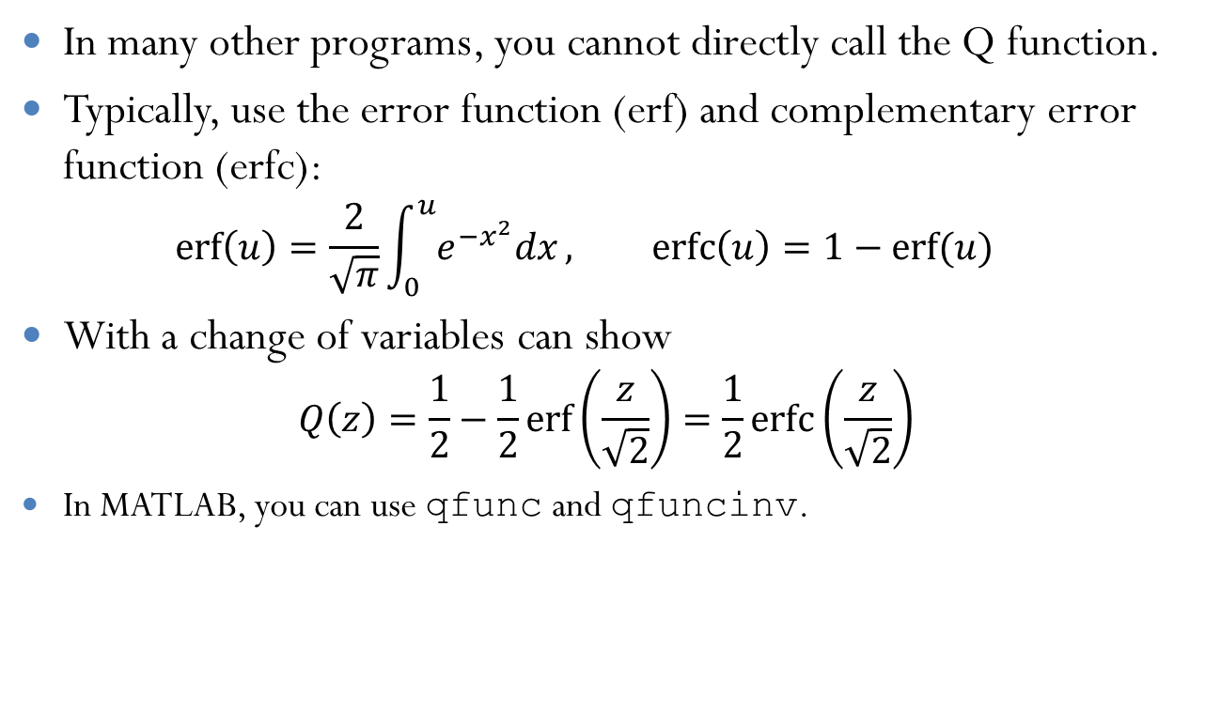
Error Function
In many other programs, you cannot directly call the Q function.
Typically, use the error function (erf) and complementary error function (erfc): $\operatorname{erf}\left(u\right)=\frac{2}{\sqrt{π}}\int_{0}^{u}{e^{−x^{2}}dx}, \operatorname{erfc}\left(u\right)=1−erf⁡(u)$
With a change of variables can show $Q\left(z\right)=\frac{1}{2}−\frac{1}{2}\operatorname{erf}\left(\frac{z}{\sqrt{2}}\right)=\frac{1}{2}\operatorname{erfc}\left(\frac{z}{\sqrt{2}}\right)$
In MATLAB, you can use qfunc and qfuncinv.

Slide 32
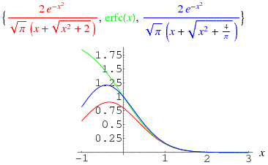
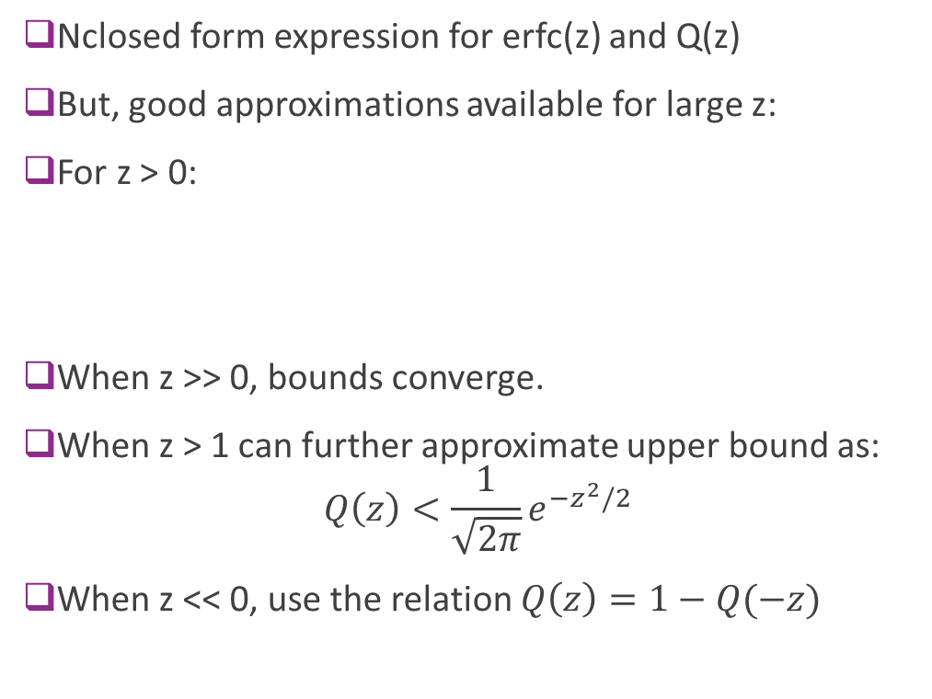
Q Function Bounds
Nclosed form expression for erfc(z) and Q(z)
But, good approximations available for large z:
For z > 0:
When z >> 0, bounds converge.
When z > 1 can further approximate upper bound as: $Q\left(z\right)<\frac{1}{\sqrt{2π}}e^{−z^{2}/2}$
When z << 0, use the relation $Q\left(z\right)=1−Q(−z)$

Slide 33
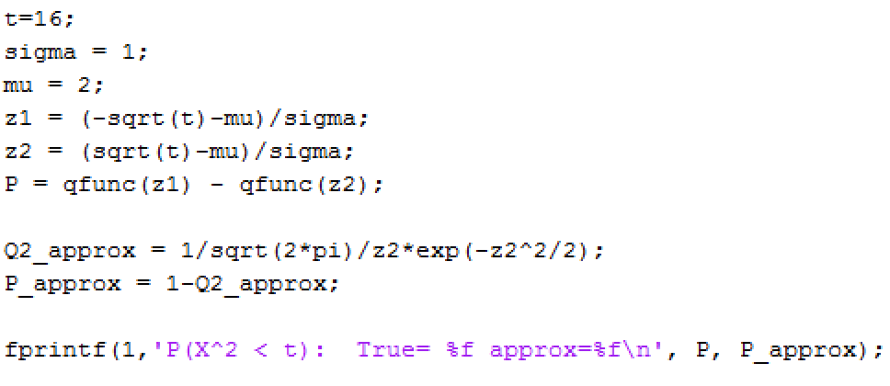
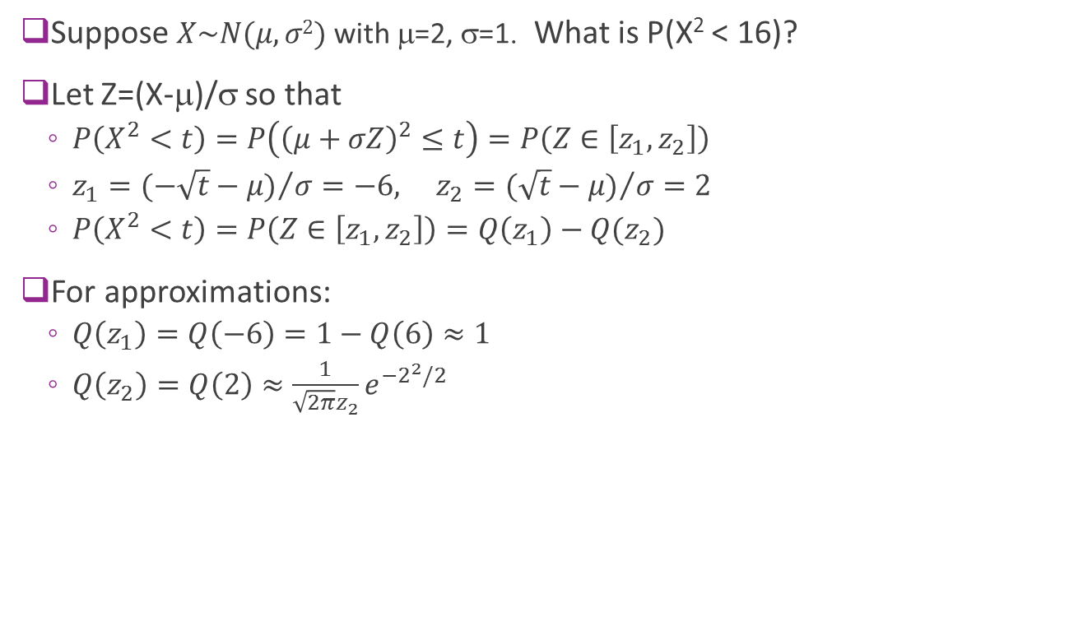
Example
Suppose $X\sim N(μ,σ2)$with μ=2, σ=1. What is P(X² < 16)?
Let Z=(X-μ)/σ so that
$P\left(X^{2}<t\right)=P\left({\left(μ+σZ\right)}^{2}≤t\right)=P\left(Z∈\left[z_{1},z_{2}\right]\right)$
$z_{1}={(−\sqrt{t}−μ)}/σ=−6, z_{2}={(\sqrt{t}−μ)}/σ=2$
$P\left(X^{2}<t\right)=P\left(Z∈\left[z_{1},z_{2}\right]\right)=Q\left(z_{1}\right)−Q(z_{2})$
For approximations:
$Q\left(z_{1}\right)=Q\left(−6\right)=1−Q\left(6\right)≈1$
$Q\left(z_{2}\right)=Q\left(2\right)≈\frac{1}{\sqrt{2π}z_{2}}e^{−2^{2}/2}$

Slide 34
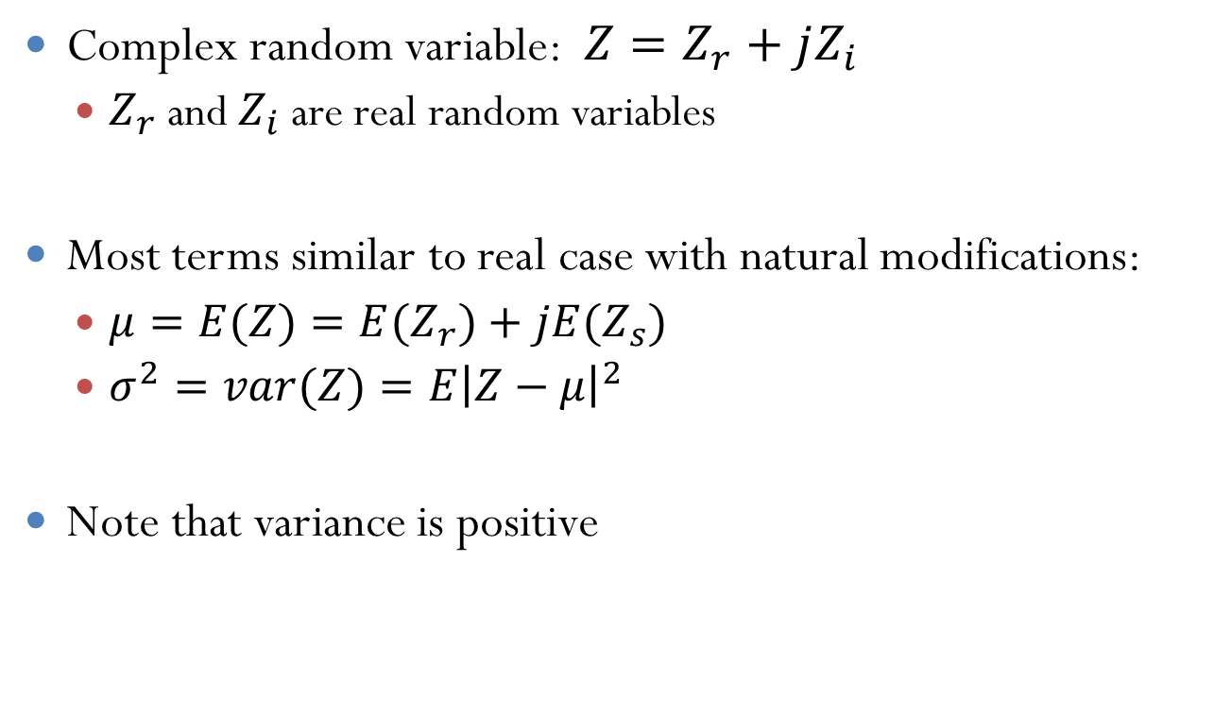
Complex Random Variables
Complex random variable: $Z=Z_{r}+jZ_{i}$
$Z_{r}$ and $Z_{i}$ are real random variables
Most terms similar to real case with natural modifications:
$μ=E(Z)={E(Z}_{r})+jE(Z_{s})$
$σ^{2}=var(Z)=E{\left|Z−μ\right|}^{2}$
Note that variance is positive

Slide 35
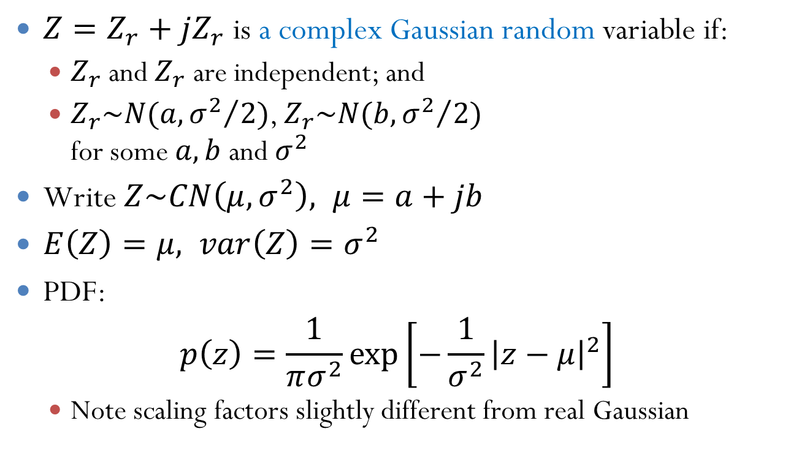
Complex Gaussian
$Z=Z_{r}+jZ_{r}$ is a complex Gaussian random variable if:
$Z_{r}$ and $Z_{r}$ are independent; and
$Z_{r}\sim N(a,{σ^{2}}/2)$, $Z_{r}\sim N(b,{σ^{2}}/2)$ for some $a, b$ and $σ^{2}$
Write $Z\sim CN\left(μ,σ^{2}\right), μ=a+jb$
$E\left(Z\right)=μ, var\left(Z\right)=σ^{2}$
PDF: $p\left(z\right)=\frac{1}{πσ^{2}}\exp\left[−\frac{1}{σ^{2}}{\left|z−μ\right|}^{2}\right]$
Note scaling factors slightly different from real Gaussian

Slide 36
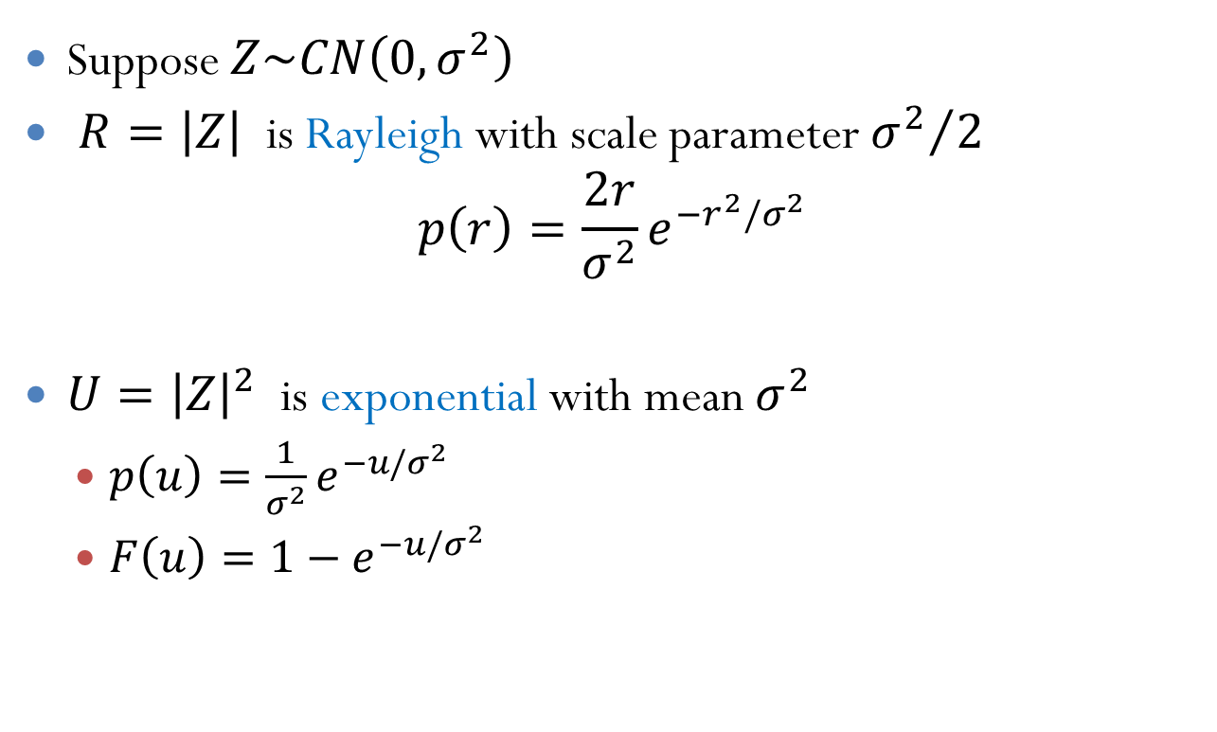
Distributions on Magnitude
Suppose $Z\sim CN\left(0,σ^{2}\right)$
$R=\left|Z\right|$ is Rayleigh with scale parameter ${σ^{2}}/2$ $p\left(r\right)=\frac{2r}{σ^{2}}e^{−r^{2}/σ^{2}}$
$U={\left|Z\right|}^{2}$ is exponential with mean $σ^{2}$
$p\left(u\right)=\frac{1}{σ^{2}}e^{−u/σ^{2}}$
$F\left(u\right)=1−e^{−u/σ^{2}}$
Exponential distribution

Slide 37

Example Calculations (On board)
Probability in an box
Probability on ${\left|Z\right|}^{2}$

Slide 38
Outline
What is noise?
Random variables
Simulating random variables
Gaussian and complex Gaussian random variables
Random vectors
Random processes

Slide 39
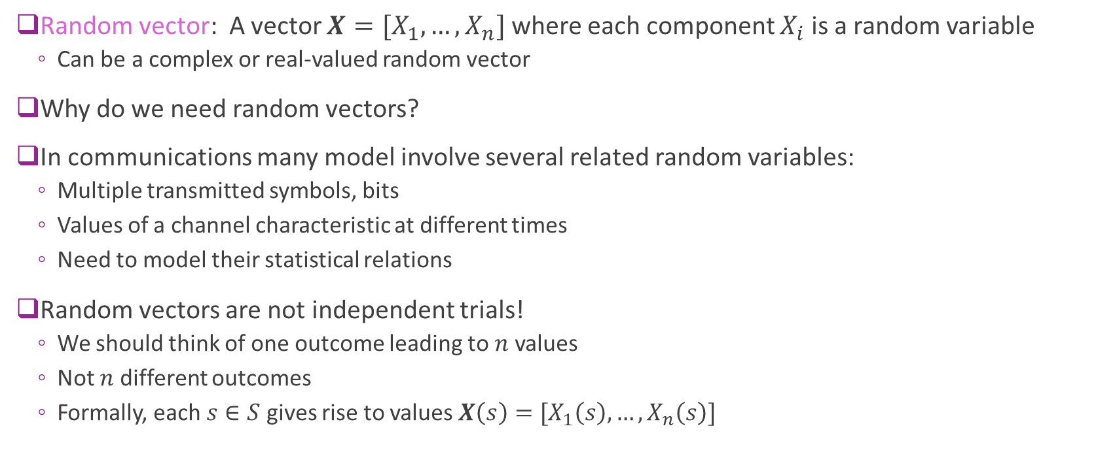
Random Vectors
Random vector: A vector $X=[X_{1},…,X_{n}]$ where each component $X_{i}$ is a random variable
Can be a complex or real-valued random vector
Why do we need random vectors?
In communications many model involve several related random variables:
Multiple transmitted symbols, bits
Values of a channel characteristic at different times
Need to model their statistical relations
Random vectors are not independent trials!
We should think of one outcome leading to $n$ values
Not $n$ different outcomes
Formally, each $s∈S$ gives rise to values $X\left(s\right)=[X_{1}\left(s\right),…,X_{n}\left(s\right)]$

Slide 40

Joint PDF and PMF
Suppose that $X=[X_{1},…,X_{n}]$ is a random vector
Discrete random variables: $X∈\{x^{(1)},…,x^{(M)}\}$
Each possible value is a vector: $x^{(m)}=[x_{1}^{\left(m\right)},…,x_{n}^{(m)}]$
Describe by a joint PMF: $P\left(X=x\right)=P(X_{1}=x_{1},…,X_{n}=x_{n})$
Continuous random vectors: Components are continuous-valued
Described by a joint PDF is:
$$p\left(x\right)=\lim_{vol\left(A\right)→0}{\frac{1}{vol(A)}}P(X∈A)$$
Limit is over sets $A⊂𝔽^{n}$ that contain $x$
Random variable is continuous if this limit exists

Slide 41

Properties of the Joint PDF
Normalization:
$p\left(x\right)≥0$ and $∫p\left(x\right)dx= ∫p\left(x_{1},…,x_{n}\right)dx_{1}⋯dx_{n}=1$
Probability in a set: $P\left(X∈A\right)=\int_{x∈A}{p\left(x_{1},…,x_{n}\right)dx_{1}⋯dx_{n}}$
Expectation: Given a vector-valued function $E\left(g\left(X\right)\right)=∫g\left(x_{1},…,x_{n}\right)p\left(x_{1},…,x_{n}\right)dx_{1}⋯dx_{n}$
Marginal PDFs: “Integrating out” the other variables
Example: Given $p\left(x_{1},x_{2},x_{3}\right)$ then $p\left(x_{1}\right)=\iint{p\left(x_{1},x_{2},x_{3}\right)dx_{2}dx_{3}}$
Similar properties for the PMF

Slide 42





Sample Problem
Suppose $p\left(x_{1},x_{2}\right)=Cx_{1}x_{2}$ on the triangular region shown
Find $C$
Find $p\left(x_{1}\right)$
Find $E\left(X_{1}X_{2}\right)$
Find $P(X_{2}>0.5X_{1})$
Solution on board
$$x_{2}$$
$$1$$
$$x_{1}$$
$$2$$

Slide 43

Conditional Density
Conditional probabilities:
Describe how random variable influences another
Conditional probability of events: $P\left(A | B\right)=\frac{P\left(A∩B\right)}{P(B)}$
Condition PDF: $p_{X|Y}\left(x | y\right)=\frac{p\left(x,y\right)}{p(y)}$
Conditional PMF: $P\left(X=x | Y=y\right)=\frac{P\left(X=x,Y=y\right)}{P(Y=y)}$
Conditional probability rule: $p_{XY}\left(x,y\right)=p_{X}\left(x\right)p_{Y|X}\left(y | x\right)=$ $p_{Y}\left(y\right)p_{X|Y}\left(x | y\right)$
Conditional expectations: $E\left(X | Y\right)=∫xp\left(x | y\right)dx$
Note these are all functions of $Y$

Slide 44



Ex 1: Power and Distance
Given a distance $D$ from a source, the received power $Y$ is exponentially distributed with $p_{Y|D}\left(y | d\right)=λ\left(d\right)\exp\left(−λ\left(d\right)y\right), y≥0, λ\left(d\right)=\frac{d^{2}}{C}$
The average power $E\left(Y | D\right)=\frac{C}{d^{2}}$ decreases with distance.
Suppose that $D$ is uniformly distributed in $d∈[d_{1},d_{2}]$
Generate 500 samples of $(D,Y)$

Slide 45

Ex 1: Power and Distance, Continued
From previous slide: $p_{Y|D}\left(y | d\right)=λ\left(d\right)\exp\left(−λ\left(d\right)y\right), y≥0, λ\left(d\right)=\frac{d^{2}}{C}, D\sim Unif\left(d_{1},d_{2}\right)$
Find $E(Y)$
From the conditional distribution: $E\left(Y | D=d\right)=\frac{1}{λ(d)}=\frac{C}{d^{2}}$
Since $D\sim Unif\left(d_{1},d_{2}\right)⇒p\left(d\right)=\frac{1}{d_{2}−d_{1}}, d∈[d_{1},d_{2}]$
From total expectation: $E\left(Y\right)=E\left[ E\left(Y | D\right)\right]=\frac{1}{d_{2}−d_{1}}\int_{d_{1}}^{d_{2}}{\frac{C}{d^{2}}dd}=\frac{C}{d_{2}−d_{1}}\left[\frac{1}{d_{1}}−\frac{1}{d_{2}}\right]=\frac{C}{d_{1}d_{2}}$
From $p(y)$
The $p\left(y\right)=∫p\left(d\right)p\left(y | d\right)dd=\frac{1}{d_{2}−d_{1}}\int_{d_{1}}^{d_{2}}{\frac{d^{2}}{C}\exp{(−\frac{yd^{2}}{c})}}dd$

Slide 46

Ex 2: Additive Channel
Suppose that $Y=X+W$ and $X,W$ are independent
Then $p_{Y|X}\left(y | x\right)=p_{W}(y−x)$
Why?
Look at CDF: $F_{Y|X}\left(y | x\right)=P\left(Y≤y | X=x\right)=P\left(X+W≤y | X=x\right)=P\left(W≤y−x | X=x\right)$
Since $X,W$ are independent: $F_{Y|X}\left(y | x\right)=P\left(W≤y−x\right)=F_{W}(y−x)$
Take derivatives: $p_{Y|X}\left(y | x\right)=\frac{∂}{∂y}F_{Y|X}\left(y | x\right)=\frac{∂}{∂y}F_{W}\left(y−x\right)=p_{W}(y−x)$

Slide 47



Ex 2. Additive Channel
Example: $Y=X+W$
$X=±1$ equiprobable
$W\sim N\left(0,σ^{2}\right), σ=0.3$
Conditional PDF:
$p\left(y | x\right)=\frac{1}{\sqrt{2π}σ}e^{−{\left(y−x\right)}^{2}/(2σ^{2})}$
Marginal PDF of $Y$:
$p\left(y\right)=p\left(y | x=1\right)P\left(x=1\right)$ $+p\left(y | x=−1\right)P(X=−1)$
Sum of two Gaussians

Slide 48
Outline
What is noise?
Random variables
Simulating random variables
Gaussian and complex Gaussian random variables
Random vectors
Random processes

Slide 49


Random Process
Communications commonly models signals via random processes
Informal definition:
Any quantity $x(t)$ that varies with time,
…and variations have uncertainty
Formal definition:
A set of random variables $x(t)$
All the random variables are on the same probability space
Sample space model:
Consider a single outcome $ω$ from sample space $S$
Each outcome results in entire sequence $s↦x(t,s)$
The resulting sequence is called a realization
Often drop dependence on $s$ and write $x\left(t\right)=x(t,s)$

Slide 50




Example 1: A Two Parameter Process
Suppose $x\left(t\right)=e^{−α(t−τ)}1_{t≥τ}$
$τ=\text{Uniform}[0,5]$: A random initial start time
$α=\text{Uniform}[0.1,3]$: A random decay rate
$α,τ$ are independent
Then $x(t)$ is a random process
Each $τ,α$ creates a realization
Write MATLAB code to generate $M=10$ random realizations
Solutions: Next slide
Decay rate $α$
Start time$τ$

Slide 51



Example 1: A Two Parameter Process
MATLAB code to generate realizations

Slide 52




Ex 2: Discrete Ex: Switching Process
Suppose $x\left[n\right]=0$ or 1
Switches with probability $p$ in each time step
Common model for many binary random processes
Ex: Channel state is good or bad
$M=3$ random realizations with $p=0.01$

Slide 53



Mean of a Random Process
The mean of a process: $μ\left(t\right)=E(x\left(t\right))$
The average value over all realizations
Example: $x\left(t\right)=e^{−αt}, t≥0$
$α=\text{Uniform}\left[a,b\right]$
$μ\left(t\right)=E\left(x\left(t\right)\right)=E\left(e^{−αt}\right)=\frac{1}{b−a}\int_{a}^{b}{e^{−αt}dα}=\frac{1}{\left(b−a\right)t}\left[e^{−at}−e^{−bt}\right]$
$a=0.2$, $b=2$
Dashed lines: Realizations $x(t)$ for different $α$
Green line: $μ\left(t\right)=E(x\left(t\right))$

Slide 54




Auto-Correlation and Auto-Covariance
Given a random process $x(t)$ (real or complex valued)
Auto-correlation: $R\left(t,s\right)=E(x\left(t\right)x^{∗}\left(s\right))$
Auto-covariance: $C\left(t,s\right)=E\left[\left(x\left(t\right)−μ\left(t\right)\right){\left(x\left(s\right)−μ\left(s\right)\right)}^{∗}\right]$
Note:
The times $t$ and $s$ are fixed
We are taking the ensemble average over $x(t)$ and $x(s)$
Describes the correlation between two different times $t$ and $s$
$$t$$
$$s$$

Slide 55


Example: Single Parameter Process
Previous example: $x\left(t\right)=e^{−αt}, t≥0$, $α=\text{Uniform}\left[a,b\right]$
$μ\left(t\right)=E\left(x\left(t\right)\right)=E\left(e^{−αt}\right)=\frac{1}{\left(b−a\right)t}\left[e^{−at}−e^{−bt}\right]$
$R\left(t,s\right)=E\left(x\left(t\right)x\left(s\right)\right)=E\left(e^{−α\left(t+s\right)}\right)$ $=\frac{1}{\left(b−a\right)(t+s)}\left[e^{−a(t+s)}−e^{−b(t+s)}\right]$
$C\left(t,s\right)=R\left(t,s\right)−μ\left(t\right)μ(s)$
Figure to right: $a=0.2, b=2$
Covariance is low for $t=s≈0$ since $x\left(t\right)≈1$ Low variance in $x(t)$
Covariance is also low for $t$ or $s≈∞$ Since $x\left(t\right)≈0$ with low variance

Slide 56

Wide Sense Stationary
A random process $x(t)$ is wide-sense stationary (WSS) if:
$μ\left(t\right)=E\left(x\left(t\right)\right)=μ$: Mean does not change with time
$R\left(t,s\right)=E\left(x\left(t\right)x^{∗}\left(s\right)\right)=R\left(t−s\right):$ Correlation depends only on difference $t−s$
Similar definition for discrete-time random process $x[n]$:
$μ\left[n\right]=E\left(x\left[n\right]\right)=μ$
$R\left[n,m\right]=E\left(x\left[n\right]x^{∗}\left[m\right]\right)=R[n−m]$
Many processes in communication can be modeled well as WSS:
Particular time does not change the statistics

Slide 57






PSD: Filtering Definition
Recall earlier definition of PSD.
Let $x(t)$ be a power signal
Select frequency $f_{0}$ to measure PSD
Filter with narrowband filter
$y\left(t\right)=h\left(t\right)∗x\left(t\right)$
$H\left(f\right)=1$ for $\left|f−f_{0}\right|≤Δ/2$
Measure power $P_{y}$
PSD at $f_{0}$ is defined as $S_{x}\left(f_{0}\right)≔ \lim_{Δ→0}{\frac{1}{Δ}}P_{y}$
$$Δ$$
$$x(t)$$
$$y(t)$$
$$P_{y}≈S_{x}(f_{0})Δ$$
$H\left(f\right):$Narrowband filter around $f_{0}$
Power meter

Slide 58

PSD for WSS Processes
PSD at $f_{0}$ is defined as $S_{x}\left(f_{0}\right)≔ \lim_{Δ→0}{\frac{1}{Δ}}P_{y}$
Theorem: Suppose that $x(t)$ is WSS. Then:
$S_{x}(f_{0})$ limit exists for all $f_{0}$
$S_{x}\left(f_{0}\right)=$ Fourier transform of $R_{x}(t)$
For WSS signals:
Can compute PSD from auto-correlation
Relates time-domain correlation to PSD
Faster varying signals have PSD at higher frequencies
$$Δ$$
$$x(t)$$
$$y(t)$$
$$P_{y}≈S_{x}(f_{0})Δ$$
$H\left(f\right):$Narrowband filter around $f_{0}$
Power meter

Slide 59

Gaussian Random Process
Definition: A random process $x(t)$ is a Gaussian random process if $\left[x\left(t_{1}\right),…,x\left(t_{K}\right)\right]$ is a Gaussian random vector for every finite set of times $t_{1},…,t_{K}$.
Can be complex or real Gaussian
Can be discrete-time or continuous-time
All probabilities can be determined from the second order statistics:
Mean $μ(t)$ and autocorrelation $R(t,s)$

Slide 60

Example Problem
Suppose that $x(t)$ is a real-valued WSS Gaussian random process with
$μ=0$ and $R\left(t\right)=P_{0}e^{−a|t|}$
Find $E{\left(x\left(t\right)−x\left(s\right)\right)}^{2}$
$E{\left(x\left(t\right)−x\left(s\right)\right)}^{2}=E\left(x{\left(t\right)}^{2}\right)−2E\left(x\left(t\right)x\left(s\right)\right)+E\left(x{\left(s\right)}^{2}\right)$ $=R\left(0\right)−2R\left(t−s\right)+R\left(0\right)=2P_{0}(1−e^{−a\left|t−s\right|})$
What is $P\left(x\left(t\right)>x\left(s\right)+c\right)$?
Let $V=x\left(t\right)−x\left(s\right)$
Since $x(t)$ is a Guassian random process, $V$ is Gaussian
$E\left(V\right)=0, var\left(V\right)=2P_{0}(1−e^{−a\left|t−s\right|})$
$P\left(x\left(t\right)>x\left(s\right)+c\right)=P\left(V>c\right)=Q\left(\frac{c}{\sqrt{2P_{0}(1−e^{−a\left|t−s\right|}) }}\right)$

Slide 61







White Gaussian Noise
$$S_{w}(f)$$
Definition: A real-valued WSS random process $w(t)$ is white if:
$E\left(w\left(t\right)\right)=0, R\left(s\right)=E\left(w\left(t\right)w\left(t−s\right)\right)=\frac{N_{0}}{2}δ(s)$
This implies PSD is flat: $S_{w}\left(f\right)=\frac{N_{0}}{2}$
Constant power across all frequencies
Infinite energy
Note the factor of 2
Complex white process:
$E\left(w\left(t\right)\right)=0, R\left(s\right)=E\left(w\left(t\right)w^{∗}\left(t−s\right)\right)=N_{0}δ(s)$
Discrete-time complex white WSS:
$E\left(w[n[\right)=0, R\left(n\right)=E\left(w\left[m\right]w^{∗}[m−n]\right)=N_{0}δ(n)$
$$\frac{N_{0}}{2}$$
$$f$$
$$S_{w}(f)$$
$$N_{0}$$
$$f$$

Slide 62

Filtered Gaussian Processes
Theorem: Suppose that $x(t)$ is WSS Gaussian and $y\left(t\right)=h\left(t\right)∗x(t)$.
Then $y(t)$ is WSS Gaussian
Notes:
Applies to real and complex-valued processes, discrete and continuous-time
PSD and autocorrelation
PSD given by: $S_{y}\left(f\right)={\left|H\left(f\right)\right|}^{2}S_{x}(f)$
Autocorrelation: $R_{y}\left(t\right)=h\left(t\right)∗\tilde{h}\left(t\right)∗R_{x}(t)$ where $\tilde{h}\left(t\right)=h^{∗}(−t)$
Any WSS Gaussian process can be obtained as $y\left(t\right)=h\left(t\right)∗w\left(t\right)$ where $w(t)$ is white.
Why? Find a stable, causal filter $H(f)$ s.t. $S_{y}\left(f\right)={\left|H\left(f\right)\right|}^{2}$
Take $w\left(t\right)$ to be white with $S_{w}\left(f\right)=1$

Slide 63

Example: First Order Filter
Suppose $x[n]$ is a real-valued, sample rate $\frac{1}{T}=100$ MHz with
$$x\left[n+1\right]=ax\left[n\right]+bw\left[n\right]$$
$w[n]$ is white $Ew{\left[n\right]}^{2}=σ_{w}^{2}$
Find $σ_{x}^{2}=E{\left|x\left[n\right]\right|}^{2}$
$x[n]$ and $w[n]$ are uncorrelated since $x[n]$ is a function of $w\left[n−1\right],w\left[n−2\right],…$
Hence $σ_{x}^{2}=Ex{\left[n+1\right]}^{2}=E\left(ax\left[n\right]+bw\left[n\right]\right)=a^{2}Ex{\left[n\right]}^{2}+b^{2}Ew{\left[n\right]}^{2} =a^{2}σ_{x}^{2}+b^{2}σ_{w}^{2}$
Therefore: $σ_{x}^{2}=\frac{bσ_{w}^{2}}{1−a^{2}}$
Find $R\left[n\right],$
$x\left[n\right]=bw\left[n−1\right]+abw\left[n−2\right]+…+a^{n−1}bw\left[0\right]+a^{n}x[0]$
Then: $R\left[n\right]=E\left(x\left[n\right]x\left[0\right]\right)=a^{n}E\left(x{\left[0\right]}^{2}\right)=a^{n}σ^{2}$ for $n>0$
Similarly, $R\left[n\right]=a^{−n}σ_{x}^{2}$ for $n≤0$
Overall $R\left[n\right]=a^{−|n|}σ_{x}^{2}$

Slide 64

Example: First Order Filter
Suppose $x[n]$ is a real-valued, sample rate $\frac{1}{T}=100$ MHz with $x\left[n+1\right]=ax\left[n\right]+bw\left[n\right]$
$w[n]$ is white $Ew{\left[n\right]}^{2}=σ_{w}^{2}$
Autocorrelation can also be computed via FT:
$H\left(Ω\right)=\frac{X\left(Ω\right)}{W(Ω)}=\frac{b}{1−ae^{−jΩ}}⇒{\left|H\left(Ω\right)\right|}^{2}=\frac{b^{2}}{{\left|1−ae^{−jΩ}\right|}^{2}}=\frac{b^{2}}{1−a^{2}−2a\cos{(Ω)}}$
Hence: $S_{x}\left(Ω\right)={\left|H\left(Ω\right)\right|}^{2}S_{w}\left(Ω\right)=\frac{b^{2}σ_{w}^{2}}{1−a^{2}−2a\cos{(Ω)}}$
Take inverse DTFT (use table): $R_{x}\left[n\right]=ℱ^{−1}\left( S_{x}\left(Ω\right)\right)=\frac{b^{2}a^{−\left|n\right|}σ_{w}^{2}}{1−a^{2}}$

Slide 65



Ex: First Order Filter Simulation
Suppose $x[n]$ is a real-valued, sample rate $\frac{1}{T}=100$ Hz with $x\left[n+1\right]=ax\left[n\right]+bw\left[n\right]$
$w[n]$ is white $Ew{\left[n\right]}^{2}=σ_{w}^{2}$
Four realizations with $a=0.99, σ_{x}^{2}=σ_{w}^{2}=1$

Slide 66
Outline
What is noise?
Random variables
Simulating random variables
Gaussian and complex Gaussian random variables
Random vectors
Random processes
AWGN models

Slide 67







Additive Noise Model
AWGN
$$w_{p}(t)$$
$$u(t)$$
$$y(t)$$
$$u_{p}(t)$$
$$r_{p}(t)$$
$$y_{p}(t)$$
Upconversion
Channel
Down- conversion
We first look at modeling thermal noise
Thermal noise:
Due to random fluctuations of electrons in the receiver
Called “thermal” since the level of the fluctuations increases with temperature
Common Additive White Gaussian Noise (AWGN) model: $y_{p}\left(t\right)=r_{p}\left(t\right)+w_{p}(t)$
$w_{p}\left(t\right)$ is real Gaussian WSS noise with PSD $\frac{N_{0}}{2}$

Slide 68

Scaling Up- and DownConversion
For noise modeling, it is convenient to use a different scaling convention
Modified scaling will keep powers in passband and baseband equal
Note: Proakis uses original scaling and has a factor of 2 in the conversion
 | Earlier scaling | Current scaling
Upconversion | $$u_{p}\left(t\right)=Real(u\left(t\right)e^{jω_{c}t})$$ | $$u_{p}\left(t\right)=\sqrt{2}Real(u\left(t\right)e^{jω_{c}t})$$
Downconversion | $$v\left(t\right)=2u\left(t\right)e^{−jω_{c}t} \\ u\left(t\right)=h_{LPF}\left(t\right)∗v(t)$$ | $$v\left(t\right)=\sqrt{2}u\left(t\right)e^{−jω_{c}t} \\ u\left(t\right)=h_{LPF}\left(t\right)∗v(t)$$

Slide 69

Downconverting Noise
Suppose that $w_{p}(t)$ is real-valued WSS noise with PSD $\frac{N_{0}}{2}$
Consider downconversion (with modified scaling factor):
$v\left(t\right)=\sqrt{2}e^{−jω_{c}t}w_{p}(t)$
$y\left(t\right)=h_{LPF}\left(t\right)∗v\left(t\right)$
Theorem: PSD of $y(t)$ is $S_{y}\left(t\right)=N_{0}{\left|H_{LPF}\left(f\right)\right|}^{2}$
Why?
$E\left(v\left(t\right)v^{∗}\left(s\right)\right)=2e^{−jω_{c}\left(t−s\right)}E\left(w_{p}\left(t\right)w_{p}\left(s\right)\right)=2e^{−jω_{c}\left(t−s\right)}δ\left(t−s\right)\frac{N_{0}}{2}=N_{0}δ\left(t−s\right)$
So $v(t)$ is complex white WSS with PSD $N_{0}$. $S_{v}\left(f\right)=N_{0}$
$S_{y}\left(f\right)={\left|H_{LPF}\left(f\right)\right|}^{2} S_{v}\left(f\right)={\left|H_{LPF}\left(f\right)\right|}^{2}N_{0}$

Slide 70









Equivalent Channel with Noise
$$w_{p}(t)$$
$$H_{p}(f)$$
Passband model:
$y_{p}\left(t\right)=h_{p}\left(t\right)∗u_{p}\left(t\right)+w_{p}(t)$
$w_{p}(t)$: additive noise in passband
Noise PSD = $\frac{N_{0}}{2}$
Complex baseband equivalent model:
$y\left(t\right)=h\left(t\right)∗u\left(t\right)+w(t)$
PSD of effective baseband noise: $S_{w}\left(t\right)=N_{0}{\left|H_{LPF}\left(f\right)\right|}^{2}$
$$u(t)$$
$$y(t)$$
Upconversion
Channel
Down- conversion
$$w(t)$$
$$H(f)$$
$$u(t)$$
$$y(t)$$
Channel

Slide 71






Effective Baseband Noise $≈$ White
Prev. slide: PSD of effective baseband noise is: $S_{w}\left(f\right)=N_{0}{\left|H_{LPF}\left(f\right)\right|}^{2}$
Suppose that $|H_{LPF}\left(f\right)|≈1$ for $\left|f\right|≤\frac{W}{2}$
Approximately constant in band of interest
Hence: $S_{w}\left(f\right)≈N_{0}$
Effective baseband PSD is approximately flat
Can be well modeled as additive white noise
$$w(t)$$
$$H(f)$$
$$u(t)$$
$$y(t)$$
Channel

